Slide 1


FAKE NEWS CLASSIFICATION USING MACHINE LEARNING TECHNIQUES
DEPARTMENT OF INFORMATION TECHNOLOGY
MCKV INSTITUTE OF ENGINEERING
(NAAC ACCREDIATED “A” GRADE AUTONOMOUS INSTITUTE)
243, G.T. ROAD(NORTH), LILUAH
HOWRAH-711204
SUBMITTED BY
Name | Univ. Roll No.
Achisman Basu | 11600721003
Anushka Nath | 11600721012
Nilanjan Dubey | 11600721028
Parambrata Chatterjee | 11600721032
Sudeshna Ghosh | 11600721057
UNDER THE GUIDANCE OF
DR. SHAMPA SENGUPTA
(Associate Professor)

Slide 2
CONTENTS
Abstract
Introduction
Literature Survey
Proposed Methodology
Working of System
Algorithm for Naïve-Bayes Classifier
Algorithm for Logistic Regression
Algorithm for Fake News Detection
Advantages & Disadvantages of Naïve-Bayes Classifier
Advantages & Disadvantages of Logistic Regression
Applications that uses Naïve-Bayes Classifier
Applications that uses Logistic Regression
Naïve-Bayes vs Logistic Regression
How Big Data is Implemented?
Result Analysis
Conclusion
Future Work
Acknowledgement
References

Slide 3
ABSTRACT
Internet is one of the important inventions and a large number of persons are its users. People use this media for different purposes. There are different social media platforms that are accessible to these users. Any user can make a post or spread the news through these online platforms. These platforms do not verify the users or their posts. So, some of the users try to spread fake news through these platforms. This fake news can be a propaganda against an individual, society, organization or political party. A human being is unable to detect all these fake news. So, there is a need for machine learning model that can detect this fake news automatically.
Our objective is to build a classification model which accurately classify a piece of news as real or fake. This method will use Naive Bayes classification model to predict whether a news is real or fake as this classifier will work better on text data and we will perform this in the big data environment. The other machine learning techniques will also be used to compare the results. So fake news classification problem can be addressed with different machine learning methods. We used Python as a language to implement the proposed method. We applied the proposed method on some benchmark dataset to classify the news as real or fake.

Slide 4
INTRODUCTION
Fake news is untrue information presented as news. It often has the aim of damaging the reputation of a person or entity or making money through advertising revenue. Once common in print, the prevalence of fake news has increased with the rise of social media, especially the Facebook News Feed.
Fake news can be intimidating as they attract more audience than normal. People use them because this can be a very good marketing strategy. But the money earned might not live up to fact that it can harm people.
In response to this challenge, researchers have developed various techniques to automatically detect and classify fake news articles. One promising approach is to use machine learning algorithms that can learn from large amounts of data to accurately classify news articles as either fake or real.

Slide 5
LITERATURE SURVEY
The title "Fake News Detection on Social Media: A Data Mining Perspective" by Shu, K., Sliva, A., Wang, S., Tang, J., & Liu, H. was published at ACM SIGKDD International Conference on Knowledge Discovery and Data Mining (KDD) on 2017. The paper proposed a system for fake news detection on social media using a data mining approach. Features include linguistic patterns, user engagement, and propagation patterns.
The title "Combating Fake News: A Survey on Identification and Mitigation Techniques" by Karimi, S., & Black, A. P. was published at ACM Computing Surveys on 2020, proposing an overview of various techniques for identifying and mitigating fake news, including machine learning, NLP, and social network analysis.
The title "Fake News Detection: A Deep Learning Approach" by Gupta, A., & Kumaraguru, P. was Published at arXiv preprint arXiv:1708.01967, on 2018 which presented a deep learning approach for fake news detection, using CNNs and RNNs for feature extraction and classification.
The title “ A scoping review of the relationship of big data analytics with context-based fake news detection on digital media in data age” by K Shahzad, SA Khan, S Ahmad, An Iqbal – Sustainability in the year 2022

Slide 6
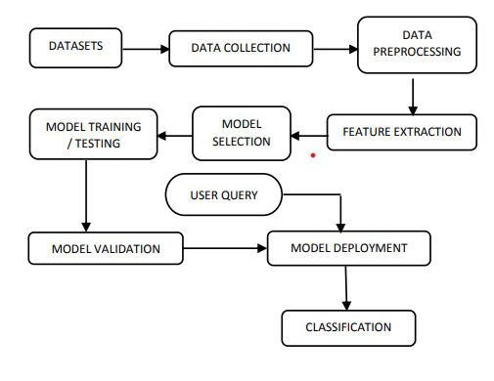
PROPOSED METHODOLOGY
FLOWCHART Of Fake News Detection:
Big Data Environment

Slide 7
Pre - Processing steps: .
Pre-processing is a crucial step in data analysis and machine learning. First we collect the raw data and then we perform pre-processing by following the steps given below:
Removing HTML tags and special characters
Tokenization (splitting text into words or sentences)
Lowercasing
Stop-word removal (removing common words like "the","and","is”, etc.)
Stemming (reducing words to their root form)
The above mentioned are the 5 pre-processing steps, we used these steps in our project and we typed the codes for the correspondence in python programming language.

Slide 8
Steps involves for Fake News Classification
The steps that involves to classify whether a news is fake or not are as follows:
Data Collection
Feature Extraction
Feature Selection
Model Building
Model Evaluation

Slide 9
Working of System
In this project for detecting whether a given news is real or fake, we used the Naïve-Bayes Classifier, along with Logistic Regression to compare between the two algorithms.
What is Naïve-Bayes Algorithm?
An algorithm that learns the probability of every object, its features, and which groups they belong to.
Also known as a probabilistic classifier.
The Naive Bayes Algorithm comes under supervised learning and is mainly used to solve classification problems.
What is Logistic Regression Analysis?
Logistic regression estimates the probability of an event occurring, such as voted or didn’t vote, based on a given data set of independent variables.
This type of statistical model (also known as logit model) is often used for classification and predictive analytics. Since the outcome is a probability, the dependent variable is bounded between 0 and 1.
In logistic regression, a logit transformation is applied on the odds—that is, the probability of success divided by the probability of failure. This is also commonly known as the log odds, or the natural logarithm of odds

Slide 10
Algorithm for Naive-Bayes Classifier
Step 1 - Import basic libraries
Step 2 - Importing the dataset
Step 3 - Data preprocessing
In this step, we have to split the dataset into a training dataset (70%) and a testing dataset (30%). Next, we have to do some basic feature scaling with the help of a standard scaler. It will transform the dataset in a way where the mean value will be 0, and the standard deviation will be 1.
Step 4 - Training the model
Step 5 - Testing and evaluation of the model
A confusion matrix helps to understand the quality of the model. It describes the production of a classification model on a set of test data for which we know the true values. Every row in a confusion matrix portrays an actual class, and every column portrays the predicted class.
Step 6 - Visualizing the model
However, in some cases, these steps might not be absolutely necessary. But the above-mentioned example provides a clear idea and information about how data points can be classified.

Slide 11
Algorithm for Logistic Regression
Step 1: Data Pre-processing
Step 2: Fitting Logistic Regression to the Training set
Step 3: Predicting the test result
Step 4: Test accuracy of the result(Creation of Confusion matrix)
Step 5: Visualizing the test set result.

Slide 12
Algorithm for Fake News Detection
Step 1: Import the libraries
Step 2: Load the datasets
Step 3: Add Labels
Step 4: Remove last 10 rows for manual testing
Step 5: Combine manual testing data
Step 6: Concatenate the datasets
Step 7: Drop unnecessary columns
Step 8: Data Preprocessing
Step 9: Split data into features and target
Step 10: Split data into train and test sets
Step 11: Vectorize the text data
Step 12: Apply Logistic Regression
Step 13: Apply Naïve- Bayes Classifier
Step 14: Compare the two classifiers
Step 15: Plot Accuracy comparison
Step 16: Plot classification report metrics comparison for Logistic Regression
Step 17: Plot classification report metrics comparison for Naïve-Bayes
Step 18: Manual Testing function
Step 19: Helper function for output label
Step 20: Manual Testing
Step 21: Apply the concepts of Big Data

Slide 13
Advantages & Disadvantages of a Naive Bayes Classifier
Advantages Disadvantages
Doesn’t require larger amounts of training data.
Straightforward to implement.
Convergence is quicker than other models, which are discriminative.
Highly scalable with several data points and predictors.
Handle both continuous and categorical data.
Not sensitive to irrelevant data and doesn’t follow the assumptions it holds.
Use in real-time predictions.
Sensitivity to Feature Scales.
Difficulty with Continuous and Numeric Data.
Lack of Model Interpretability.
Limited Expressiveness.
Data Scarcity Issues.
Not Suitable for Imbalanced Datasets.
Difficulty with Capturing Non-Linear Relationships.

Slide 14
Advantages & Disadvantages of Logistic Regression
Advantages
Disadvantages
Easier to implement machine learning methods
Suitable for linearly separable datasets
Provides valuable insights
Probabilistic interpretation
Less prone to overfitting
Assumption of linearity
Limited expressiveness
Sensitivity to outliers
Not suitable for complex relationships
Binary outcome limitation

Slide 15
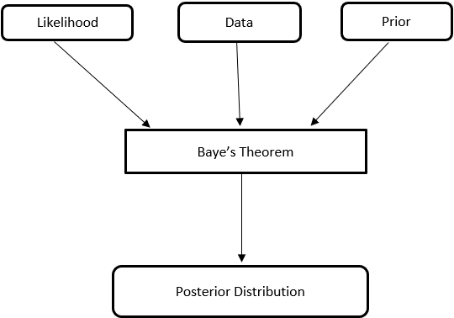
Applications that use Naive Bayes Classifier
Text classification
Fake News Classification
Sentiment analysis
Recommendation system
Spam filtering
Medical diagnosis.
Credit Scoring
figure: Bayes Theory from a ML standpoint

Slide 16
Applications that use Logistic Regression
Fraud detection
Disease prediction
Churn prediction
Crime Prediction
Species Distribution Modelling

Slide 17
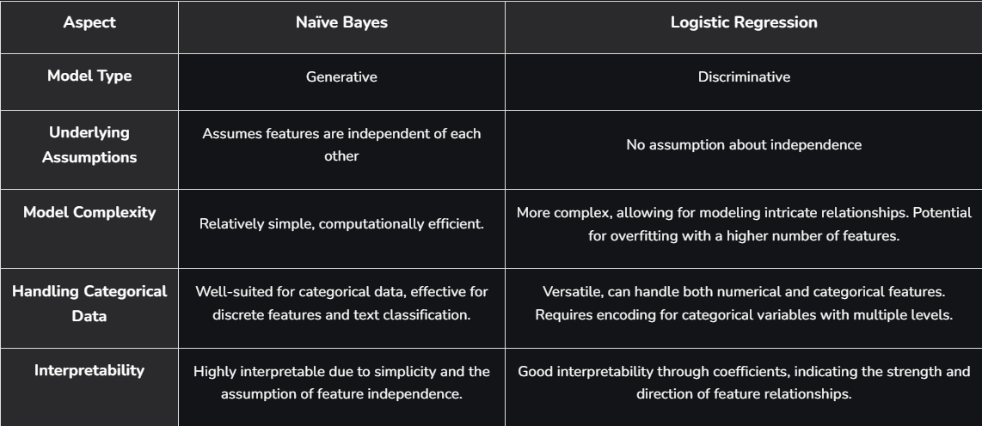
Naïve Bayes Classifier VS Logistic Regression

Slide 18
How Big Data is implemented?
Setup the MRJob Class
Define the Mapper Function
Define the Reducer Function
Define Preprocessing Function
Run the MRJob

Slide 19
Result Analysis
The proposed fake news classification system was implemented using a machine learning approach. A comprehensive dataset of news articles from Indian news sources was collected, which included both real and fake news articles. The collected dataset was pre-processed by removing stop words and punctuation marks, and relevant features were extracted using word frequency and NLP. We used Naïve-Bayes for this project, and Logistic Regression for comparing the results accuracy in the big data environment.
The results of the proposed fake news classification system indicate that the use of machine learning algorithms can be effective in identifying fake news articles. The high accuracy achieved by the system shows that it has the potential to be a useful tool in combatting the spread of misinformation and fake news.
However, there are some limitations to the proposed system. The performance of the system may be impacted by the quality and quantity of the training data, as well as the choice of machine learning algorithm. Additionally, the system may not be able to detect sophisticated fake news articles that are designed to mimic real news articles.
Despite these limitations, the proposed system represents an important step forward in the development of tools for combatting fake news. Future research could explore ways to improve the performance of the system, such as by incorporating more sophisticated features or by using more advanced machine learning techniques.

Slide 22
CONCLUSION
In conclusion, Naive Bayes classifiers and Logistic Regression offer a balance between simplicity, efficiency, and interpretability for fake news detection. Understanding their strengths and limitations is crucial for effective deployment in real-world applications.
The system represents a valuable contribution to the development of tools for combating fake news. As the spread of misinformation and fake news continues to be a major problem in our society, there is a growing need for effective solutions to address this issue.
The system, along with other similar systems being developed, has the potential to be an important tool for media and news organizations, policymakers, and social media platforms to combat the spread of fake news and promote a more informed and responsible society.
Our project can ring the initial alert for fake news. This is a very complex problem but we tried to address it as much as we could. Projects like this one with more advanced features should be integrated on social media to prevent the spread of fake news.
Fake news detection using machine learning algorithms is a promising approach to combating fake news. Machine learning algorithms can analyse large datasets, through the concepts of Big Data that is applied in our project and identify patterns that are commonly found in fake news articles.

Slide 23
Future Work
Till the time being we have implemented the machine learning algorithms to classify a news from any dataset as real or fake, but for big data environment will implemented it through mapper and reducer but in future we will use some of the bench mark data for implementation.

Slide 24
ACKNOWLEDGEMENT
It is our great privilege to express our profound and sincere gratitude to our Project Supervisor, Dr. Shampa Sengupta for providing us a very cooperative and precious guidance at every stage of the present project work being carried out under her supervision. Her valuable advice and instructions in carrying out the present study has been a very rewarding and pleasurable experience that has greatly benefited us throughout the course of work.
We would like to convey our sincere gratitude towards Head of the Department of Information Technology of MCKV INSTITUTE OF ENGINEERING for providing us the requisite support for timely completion of our work. We would also like to pay our heartiest thanks and gratitude to all the teachers of the INFORMATION TECHNOLOGY for various suggestions being provided in attaining success in our work

Slide 25
REFERENCES
"Fake News Detection on Social Media: A Data Mining Perspective" by Shu, K., Sliva, A., Wang, S., Tang, J., & Liu, H.
"Combating Fake News: A Survey on Identification and Mitigation Techniques" by Karimi, S., & Black, A. P.
"Fake News Detection: A Deep Learning Approach" by Gupta, A., & Kumaraguru, P.
https://www.turing.com/kb/an-introduction-to-naive-bayes-algorithm-for-beginners
The title A scoping review of the relationship of big data analytics with context-based fake news detection on digital media in data age by K Shahzad, SA Khan, S Ahmad, An Iqbal – Sustainability in the year 2022

Slide 26
Thank You!

